Slide 1

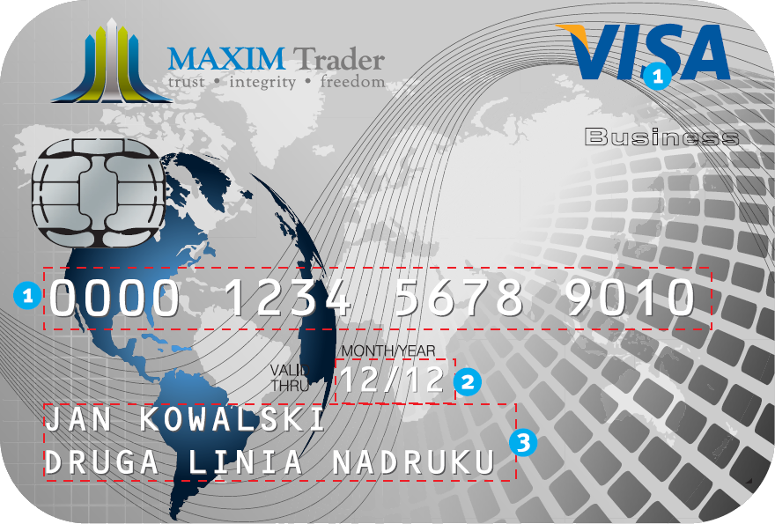







Apply Maxim Trader
VISA Debit Card NOW!
APPLY NOW!
Change the way you pay, and receive your money.
Safer than carrying cash.

Slide 2
Apply Maxim Trader
VISA Debit Card NOW!
APPLY NOW!
Change the way you pay, and receive your money.
Safer than carrying cash.

